Slide 1


NMAP
(NETWORK MAPPER)
Presented by:
YUVAPRIYA S

Slide 2

PROBLEM STATEMENT
Network Vulnerability Scanning with Nmap:
Use Nmap to scan a network for open ports and services. Analyze the scan results to identify potential security vulnerabilities (e.g., outdate services, unpatched software). Discuss the importance of regular vulnerability scanning and patch management to mitigate these risks

Slide 3

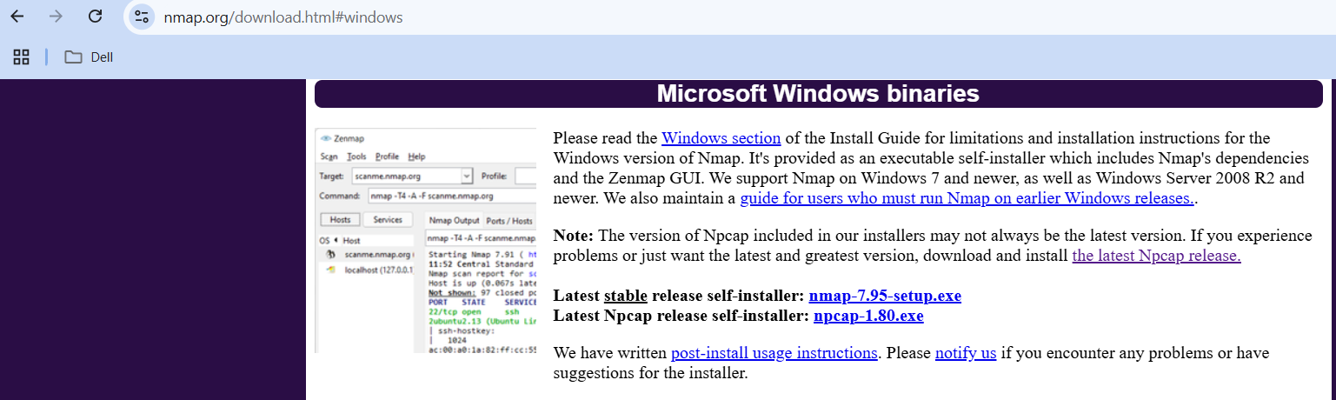
INSTALLATION

Slide 4
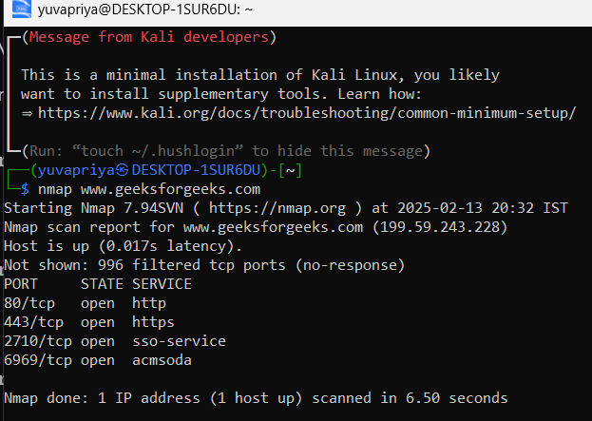
Using Kali Linux:
Basic Network Scan:
nmap <target ip>:This scans the target system for open ports.

Slide 5
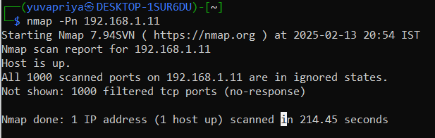
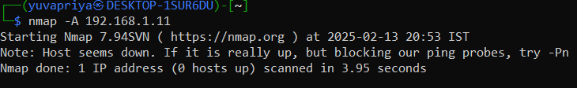
Runs various vulnerability detection scripts from the Nmap Scripting Engine (NSE).
Performs an in-depth scan, including OS detection, traceroute,script scanning.

Slide 6
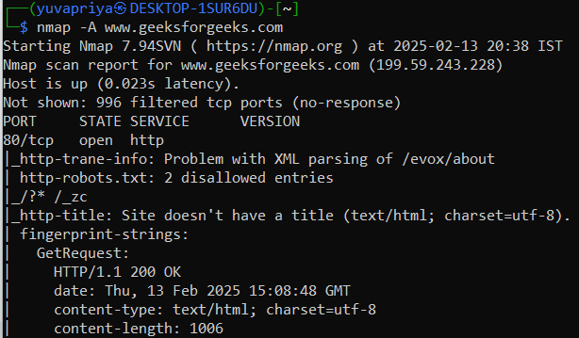
Aggressive Scan (Includes OS Detection and More Details):

Slide 7
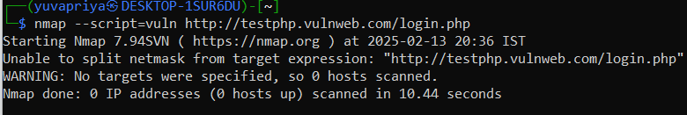
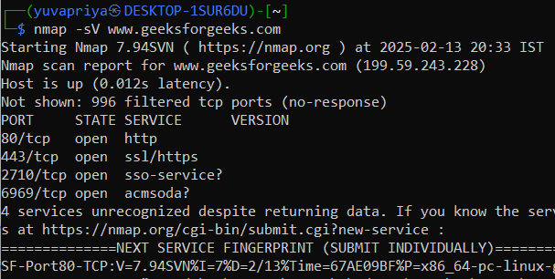
Scans for vulnerabilities
Scanning for Open Ports and Services:enables service version detection:

Slide 8



Using NMAP
Demo link video:
https://drive.google.com/file/d/1yvXIaBMWja5AwGlK43Sq6oxGceIAg5Ju/view?usp=sharing

Slide 9
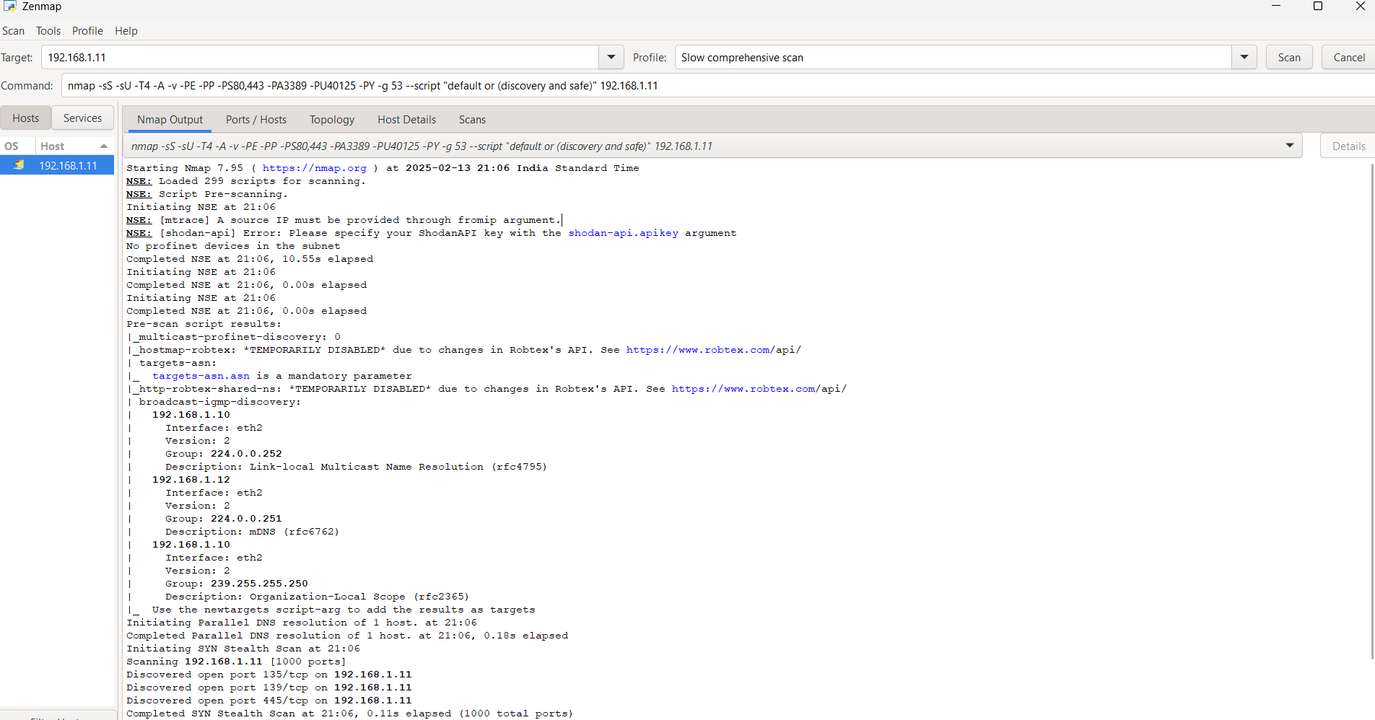

Slide 10
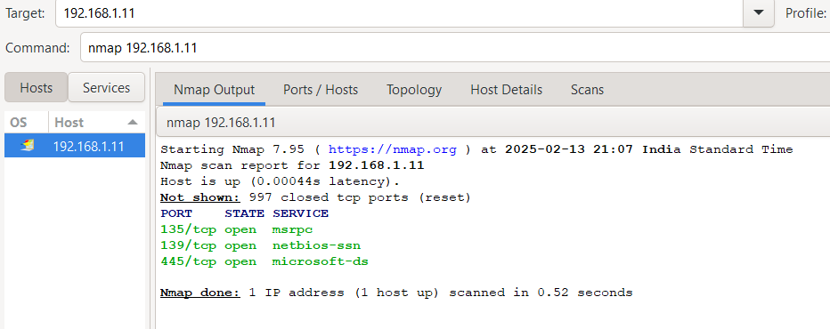
Basic Network scan

Slide 11
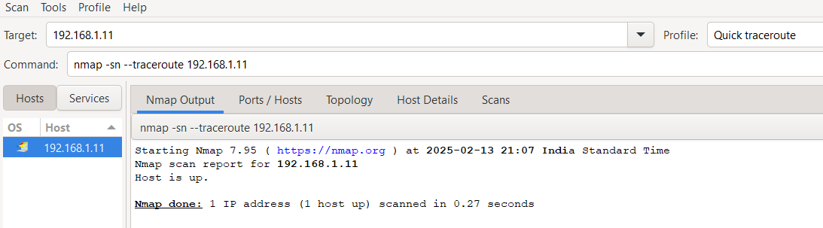
-T4 → Sets a faster scan speed (T0 to T5, where T4 is fast and T5 is very aggressive).
-A → Enables aggressive mode, which includes:
OS detection
Version detection
Script scanning
Traceroute

Slide 12
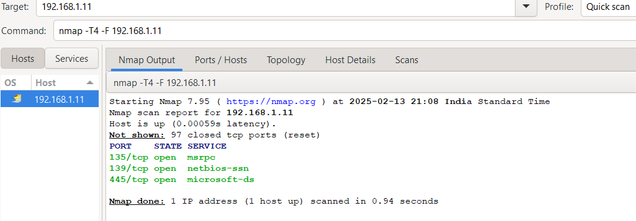
-T4 → Fast scan speed (like before).
-F → "Fast mode" scan, which scans only the most common 100 ports instead of all 65,535.
Perform a fast scan with a limited set of ports.

Slide 13
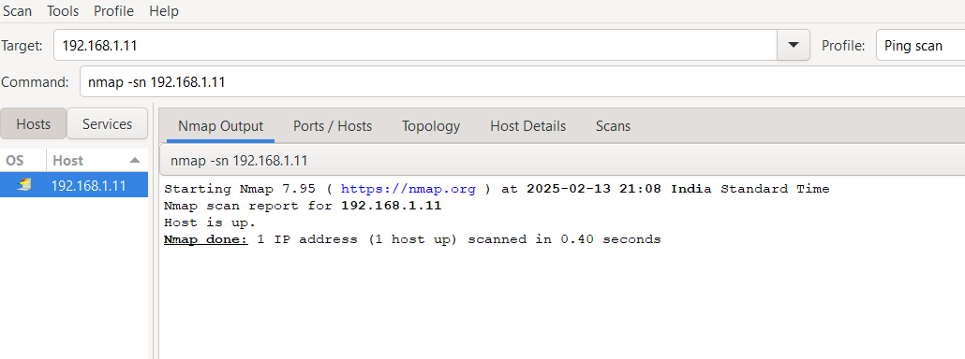
Purpose: Ping scan (checks if the target is online, no port scanning).
🔹 Breakdown:
-sn → Skips port scanning, only checks if the host is up.

Slide 14
REGULAR VULNERABILITY SCANNING AND PATCH MANAGEMENT
Cyber threats constantly evolve, making regular vulnerability scanning and patch management essential for protecting systems from security risks. Organizations must proactively detect vulnerabilities and apply patches to prevent data breaches, unauthorized access, and service disruptions.
Why Regular Vulnerability Scanning is Important
Vulnerability scanning helps identify security weaknesses in a network, system, or application before attackers exploit them.
🔹 Detects Open Ports & Weak Services – Unused open ports and outdated services are potential attack vectors.
🔹 Identifies Outdated Software & Misconfigurations – Old software versions may contain known vulnerabilities.
🔹 Assists in Compliance & Security Audits – Many regulatory standards (e.g., ISO 27001, PCI-DSS) require frequent scanning.
🔹 Reduces Attack Surface – Finding and fixing vulnerabilities early prevents exploitation.

Slide 15
ROLE OF PATCH MANAGEMENT IN RISK MITIGATION
Once vulnerabilities are identified, patch management ensures that software and systems stay up to date with security fixes.
Closes Security Gaps – Patching fixes known exploits, reducing the risk of cyberattacks.
Improves System Performance – Updates often include optimizations and stability improvements.
Ensures Compliance – Many regulations mandate regular patching to maintain security standards.
Prevents Zero-Day Attacks – Timely patching minimizes the risk of zero-day vulnerabilities being exploited.
Example: If Nmap detects an outdated Apache server, updating it prevents potential remote code execution (RCE) exploits.

Slide 16

REFERENCES
https://nmap.org/download.html#windows
Tools used
i) Kali Linux
ii) NMAP

Slide 17
THANK
YOU
yuvapriya s
2022503552

